Slide 1



AI in Mathematics
Lecture 1
Bar-Ilan University
Nebius Academy | Stevens Institute of Technology
March 18, 2025

Slide 2
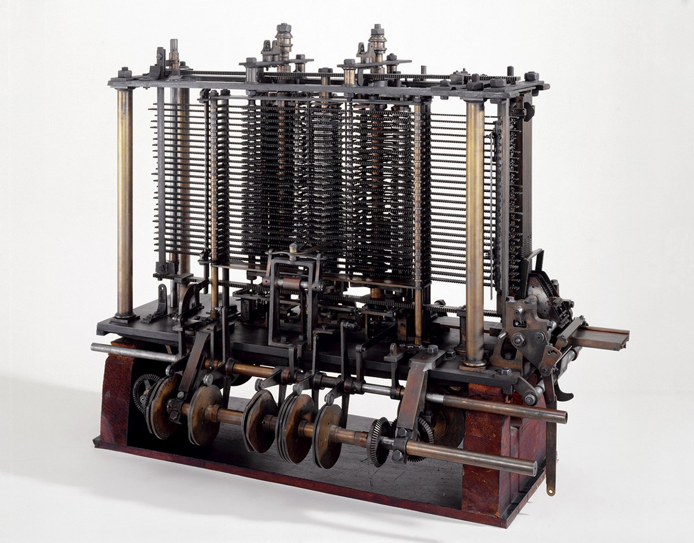
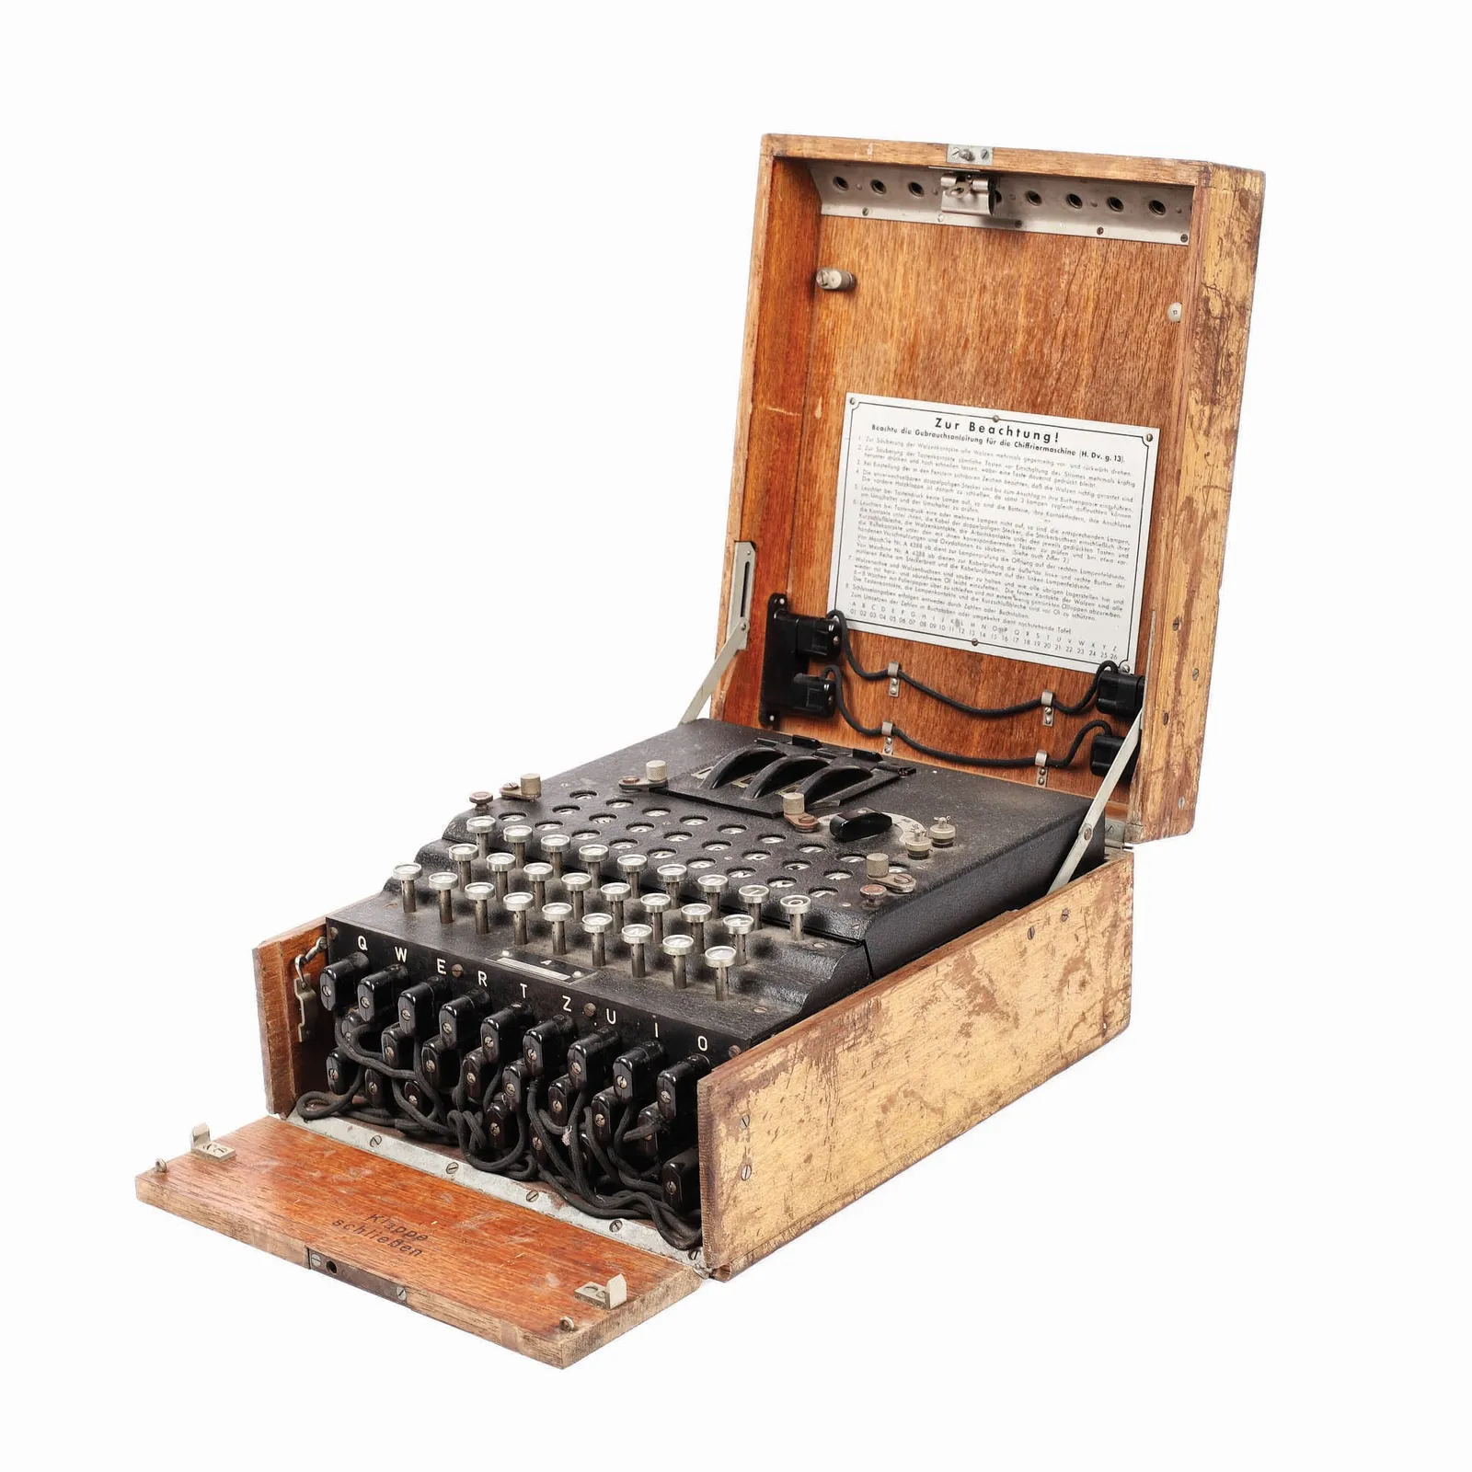
Computers in Mathematics
The Pioneering Era (Mid-20th Century)

Slide 3

Computers in Mathematics
The Four Color Theorem

Slide 4
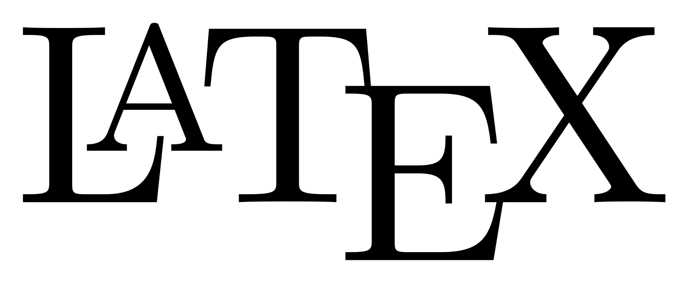


Computers in Mathematics
Software and globalization

Slide 5
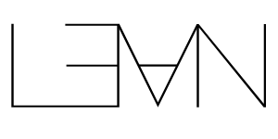
Computers in Mathematics
Formal Proof Assistants

Slide 6
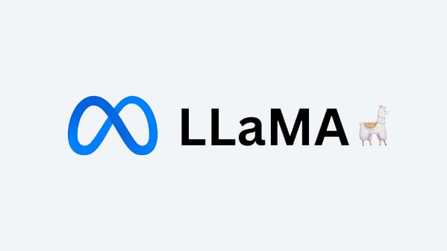

Computers in Mathematics
AI and LLMs everywhere

Slide 7
AI IN MATHEMATICS
Large Language Models (LLMs)
Formal Proof Assistant
Machine Learning
Algorithms
Mathematical search engine
Provides explanations
Math Problem Solving
Software tools for theorem proving
Verifies proofs
Makes you structure proofs
Generates examples
Discovers new structures and relationships
Pushes the boundaries of solving methods

Slide 8




Large Language Models (LLMs)
Examples:
Predict the next “word” based on previously generated tokens and the given context.
Recent developments:
Non-linear reasoning
Usage of Agents

Slide 9


Formal Proof Assistants
Examples:
Check out: https://adam.math.hhu.de
Verify mathematical proofs with absolute rigor.
Reduce the need in human reviews
Generate datasets of proofs
Allow simpler collaboration

Slide 10


IMO Participation
AI won “silver” medal on International Math Olympiad!
Solved the hardest (for humans) problem of the Olympiad.
Wrote proofs in Lean and scored 28/42 points (just one point shy of a gold medal).
Three days to find the solution.
Didn’t solve combinatorics. Apparently, AI is not a fan of this field!

Slide 11
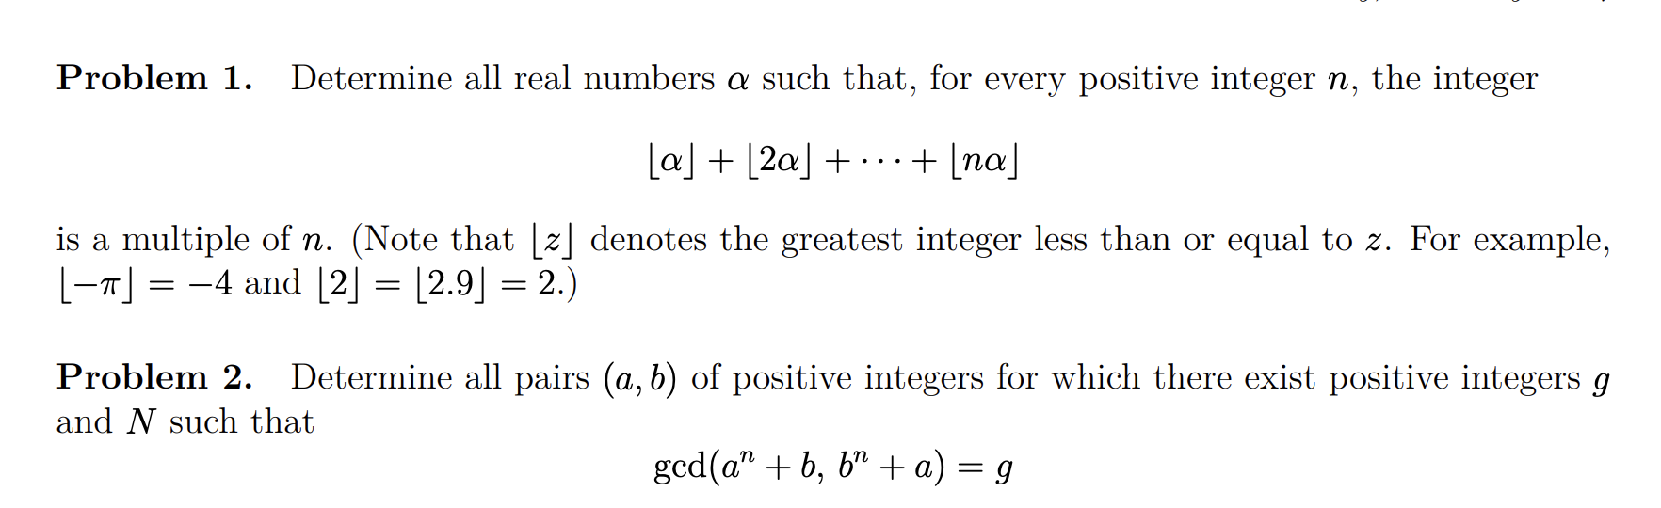
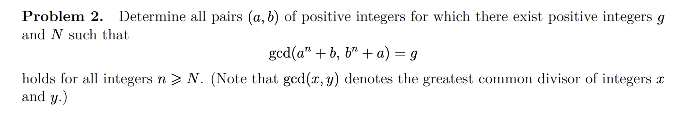
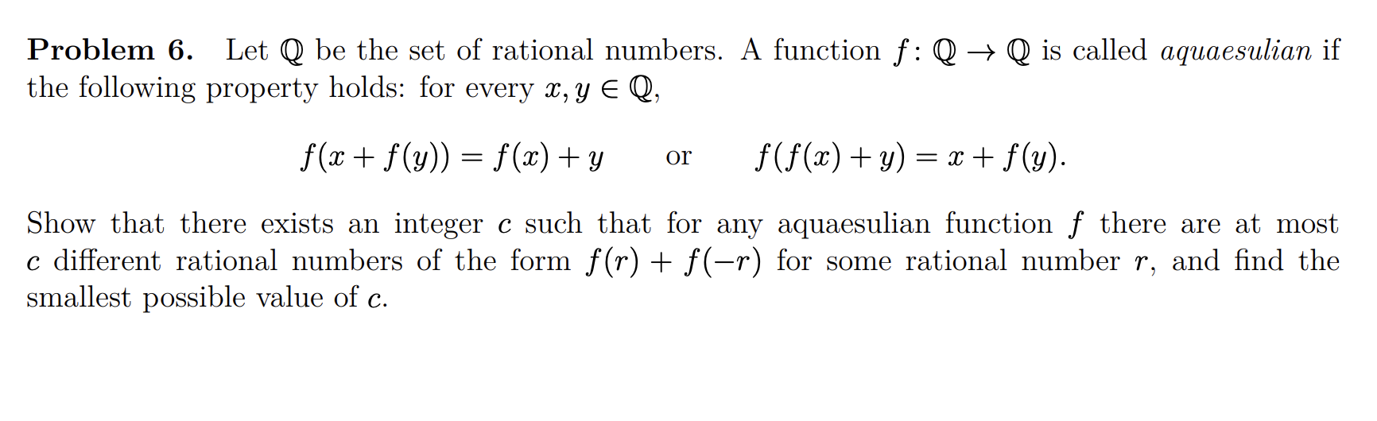
AlphaProof solved

Slide 12
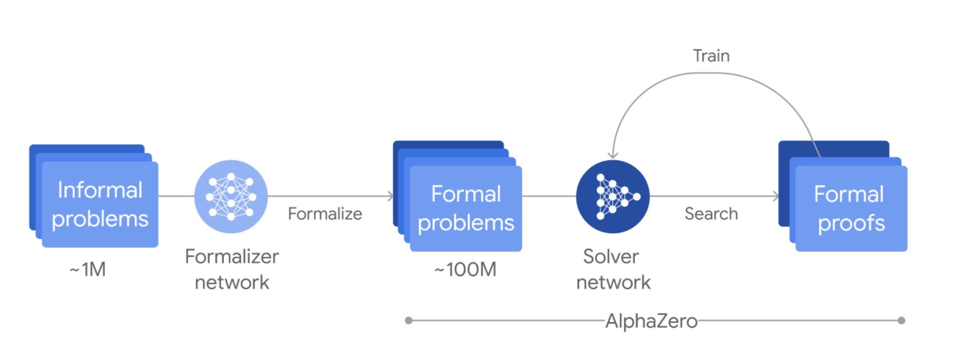
AlphaProof

Slide 13
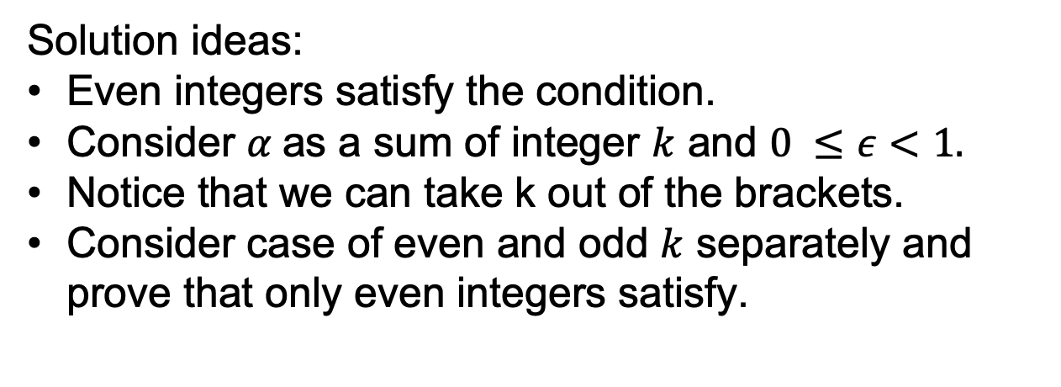
Problem 1
Solution ideas:
Even integers satisfy the condition.
Consider $α$as a sum of integer $k$ and $0 ≤ε<1.$
Notice that we can take k out of the brackets.
Consider case of even and odd $k$ separately and prove that only even integers satisfy.

Slide 14
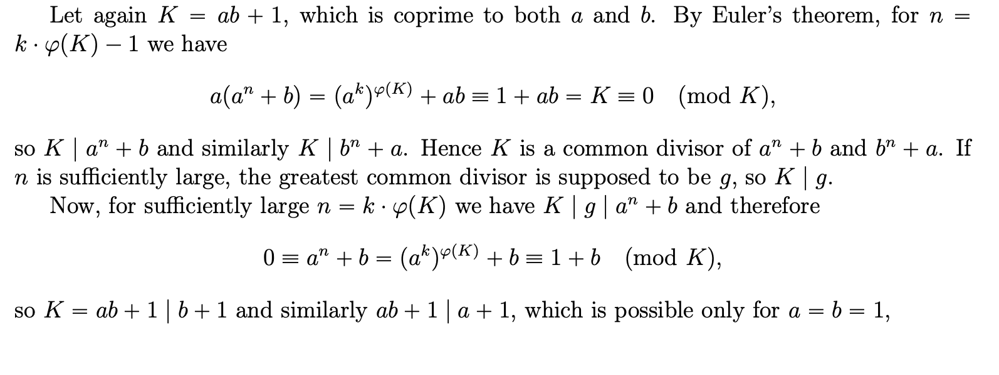
Problem 2

Slide 15
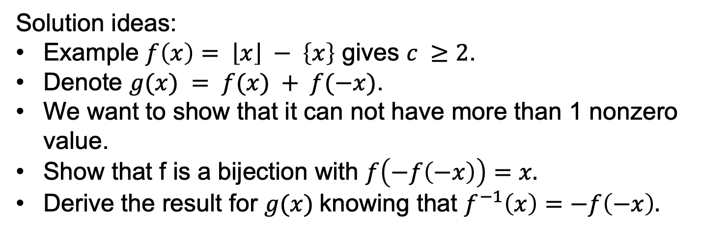
Problem 6
Solution ideas:
Example $f\left(x\right)= \left\lfloor x\right\rfloor − \left\{x\right\}$ gives $c ≥2$.
Denote $g(x) = f(x) + f(−x)$.
We want to show that it can not have more than 1 nonzero value.
Show that f is a bijection with $f\left(−f\left(−x\right)\right)=x.$
Derive the result for $g(x)$knowing that $f^{−1}\left(x\right)=−f\left(−x\right).$

Slide 16
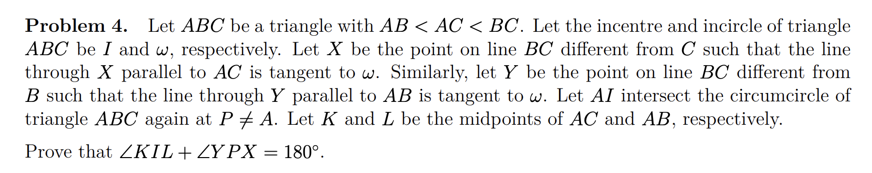
AlphaGeometry solved
in 19 seconds…
Much stronger than AlphaProof:
Solves almost all geometry problems from IMO this century.

Slide 17
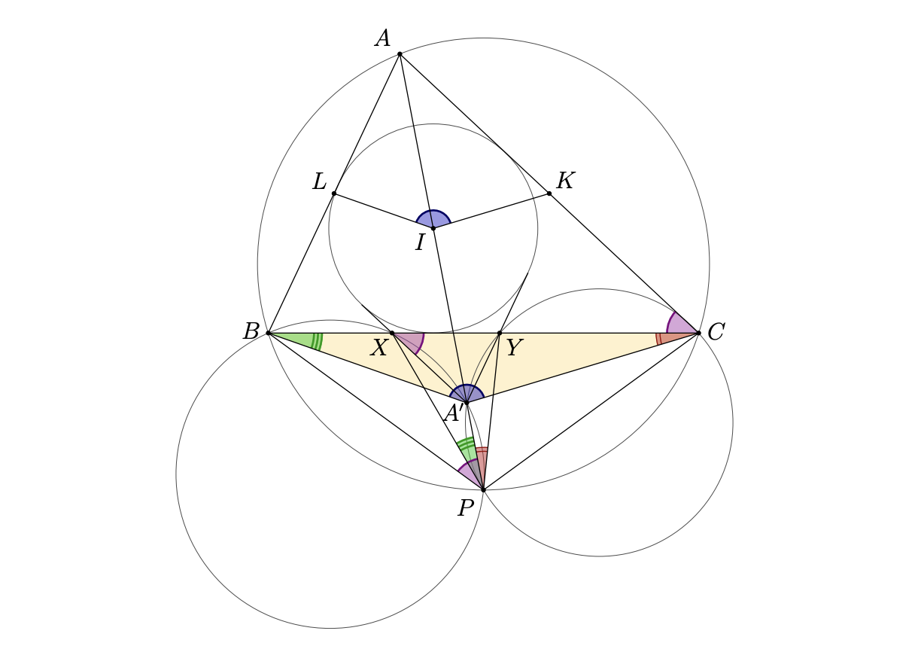
AlphaGeometry solved

Slide 18
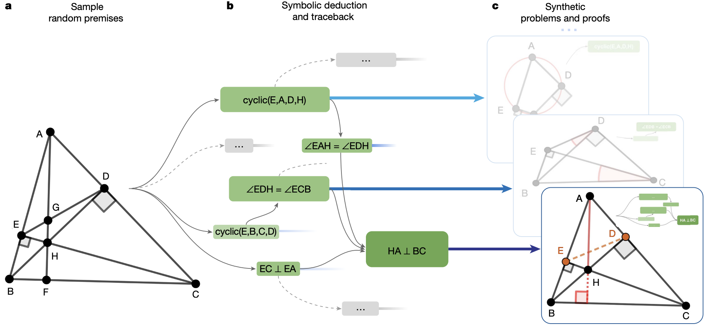
AlphaGeometry

Slide 19
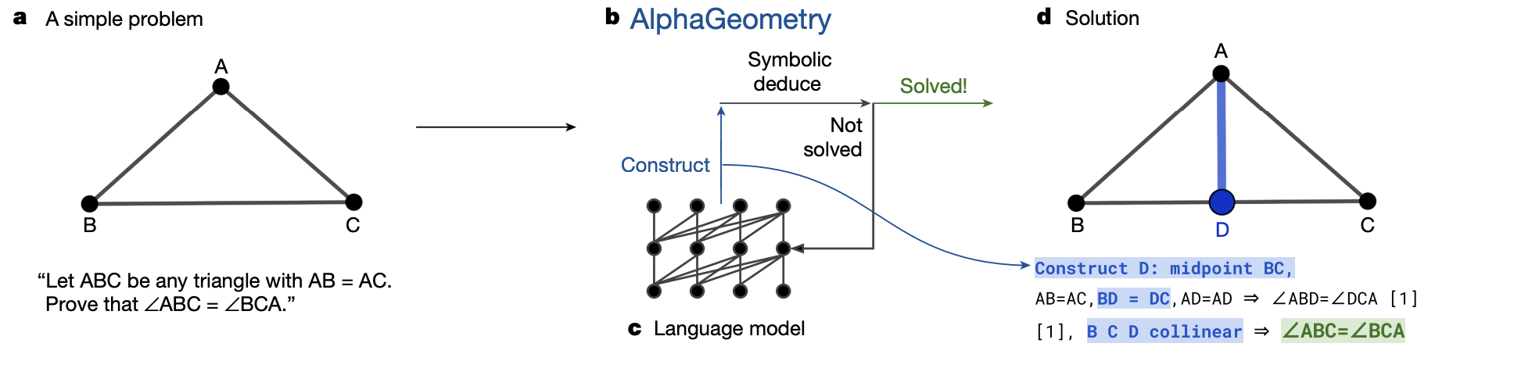
AlphaGeometry

Slide 20
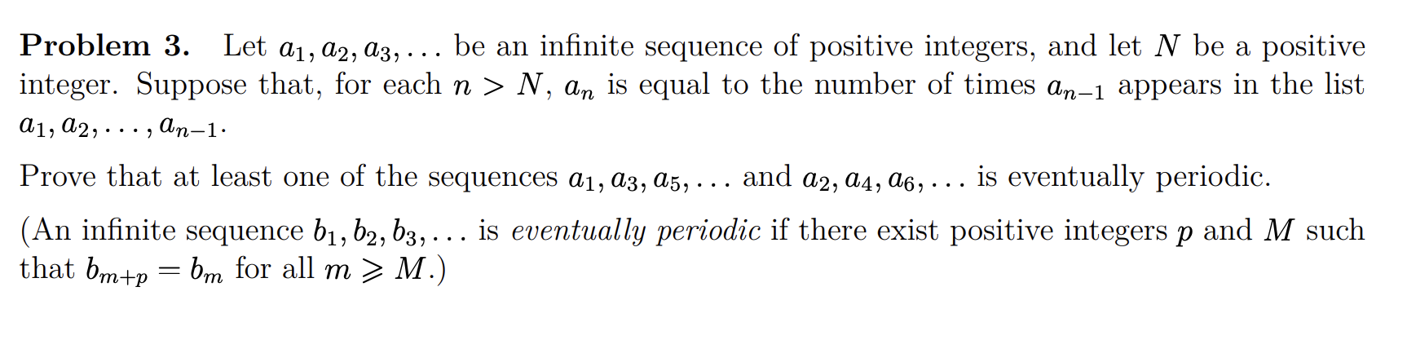
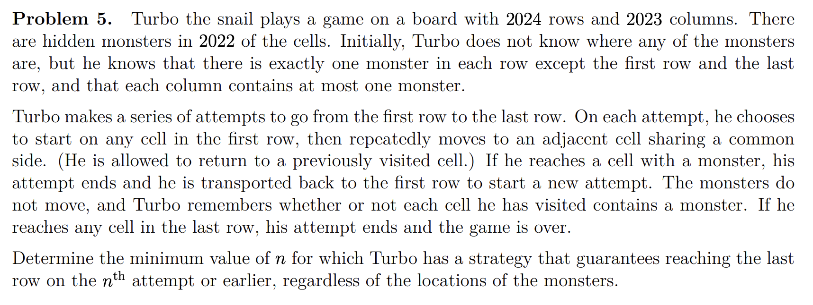
AlphaProof didn’t solve
Is it too lazy to read so many words?)

Slide 21
Problem 3
Ideas:
At least one integer appears infinitely often.
Only finitely many integers appear infinitely often.
Classify numbers and show the sequence eventually alternates between “big” and “small.”
Analyze the “small” terms to show eventual periodicity.

Slide 22
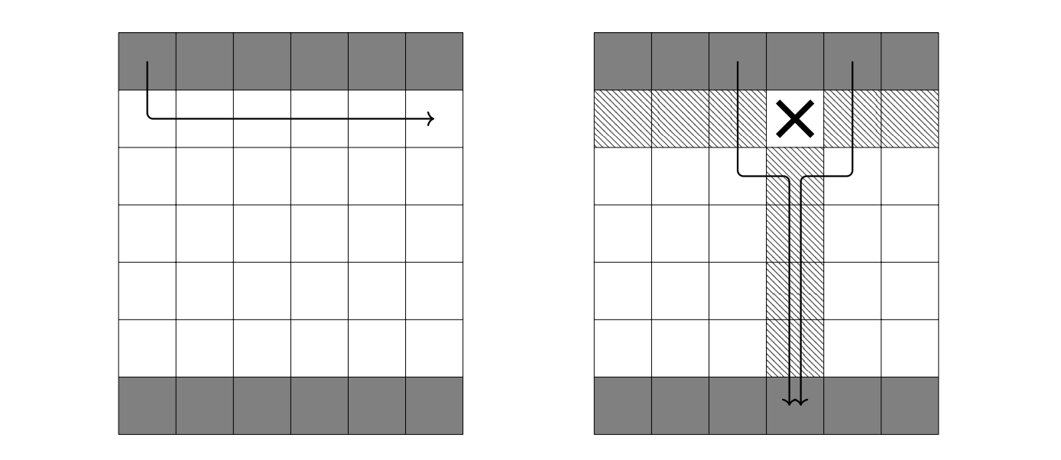
Problem 5
Answer: n = 3

Slide 23
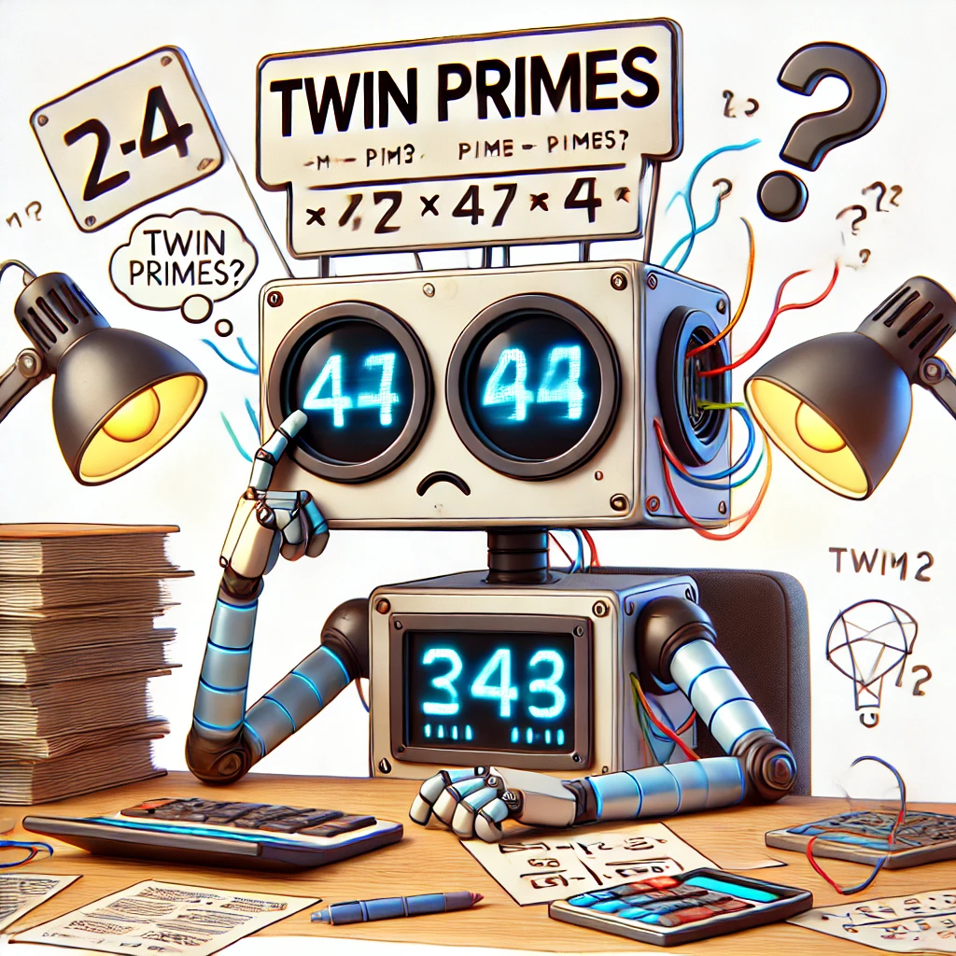
AI and Mathematics
And now we will look at some examples how machine learning solves real mathematical problems

Slide 24
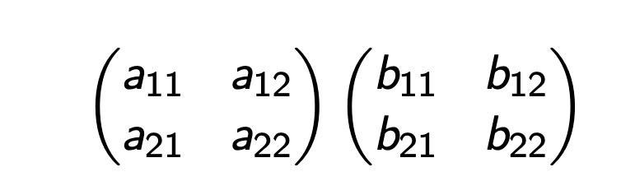
AI and Matrix Multiplication
Consider multiplying two matrices:
How many multiplications are needed in the classical approach?

Slide 25
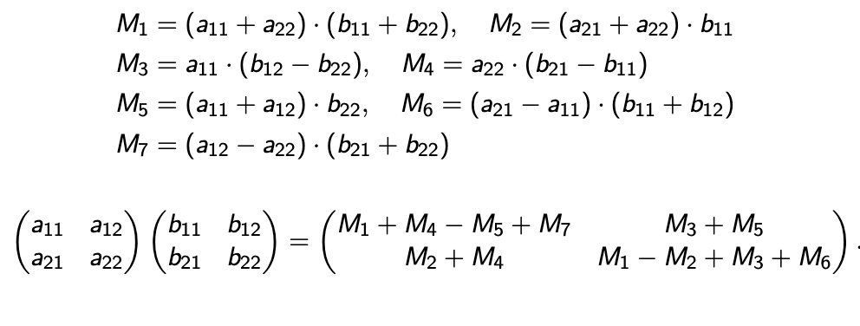
AI and Matrix Multiplication
We can do 7!!!!

Slide 26
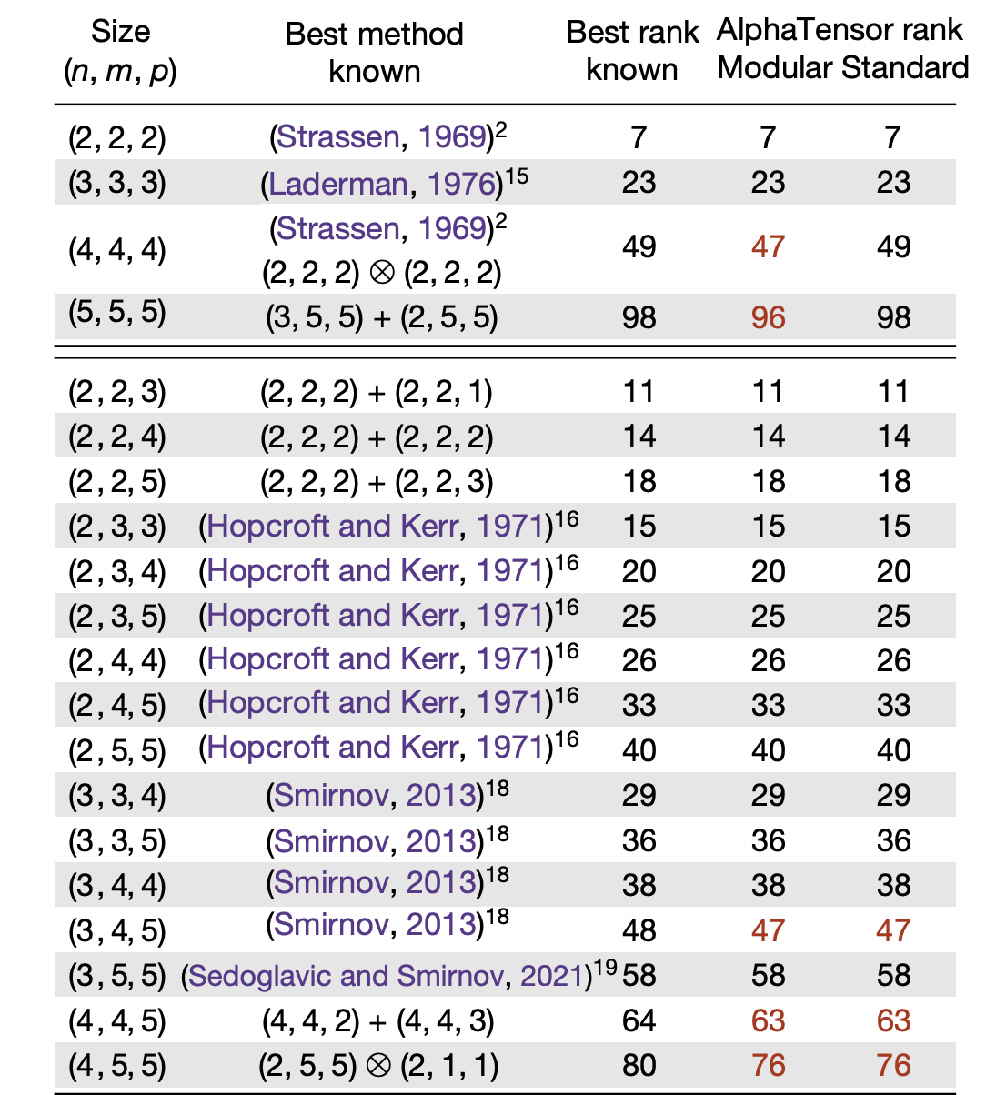
Alpha Tensor results

Slide 27
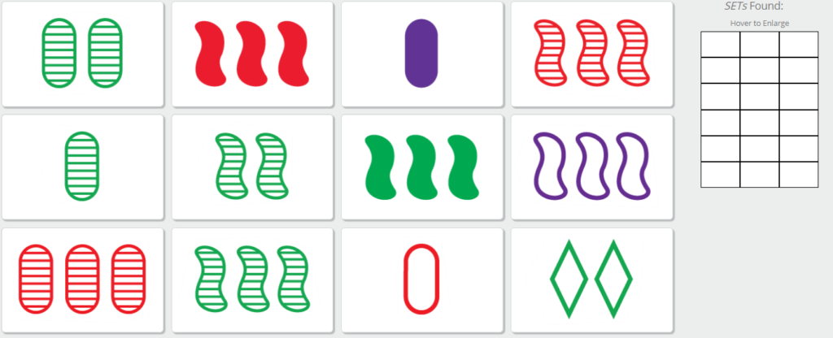
The SET Game

Slide 28

The SET Game
What mathematical structure do the cards correspond to?
(diamond, 2, red,open)

Slide 29
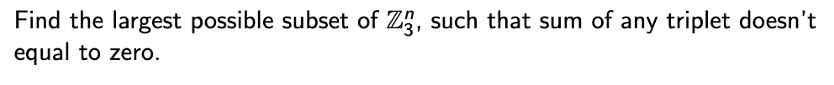
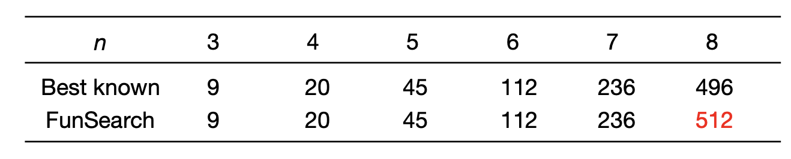
AI improved the results!

Slide 30
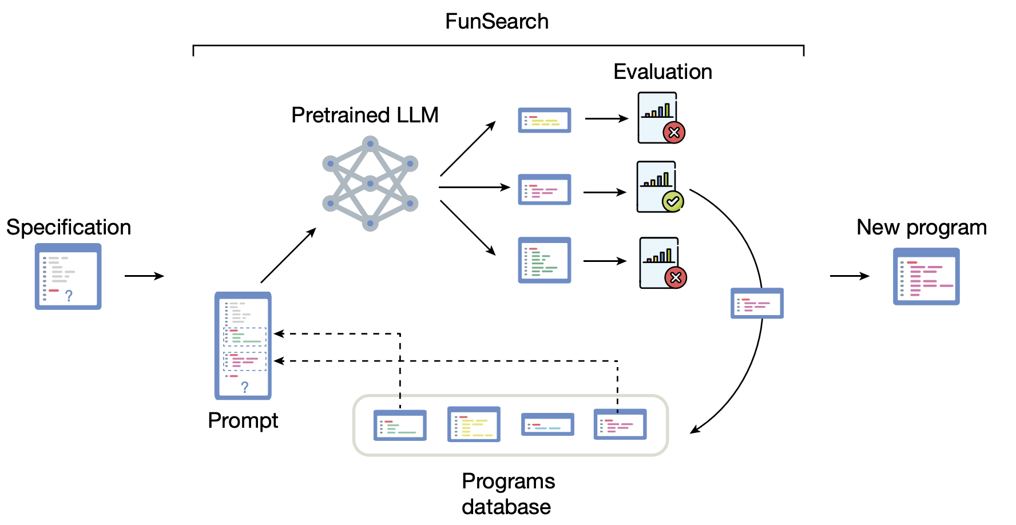
How AI Helped in the Capset Problem?

Slide 31
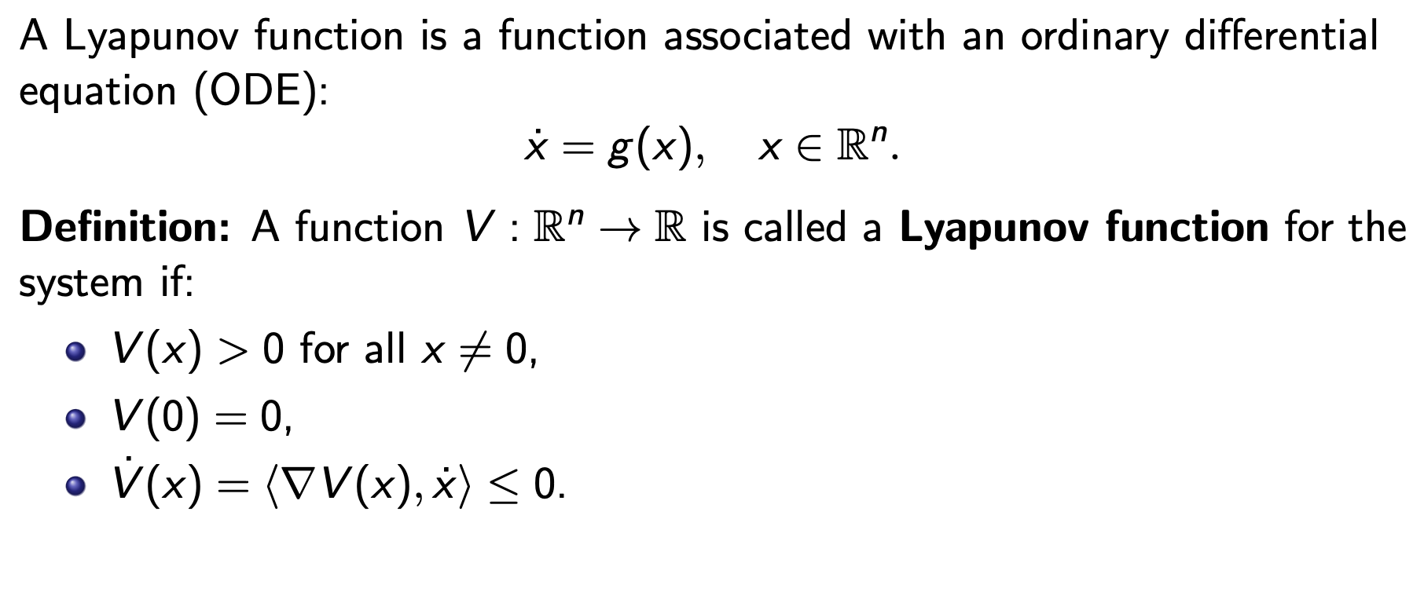
Lyapunov Functions
Why are they important?
Lyapunov function ⇔ Stable system

Slide 32
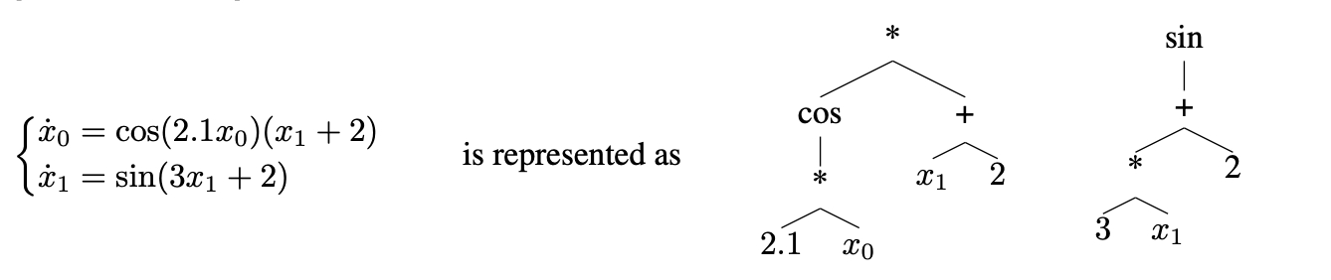
Lyapunov Functions
Even writing system of equation in a machine readable text is challenging:

Slide 33
Lyapunov Functions
AI found Lyapunov functions on a test dataset 84% of the time, while Master’s students in relative field only solved 9.3% of those equations.

Slide 35
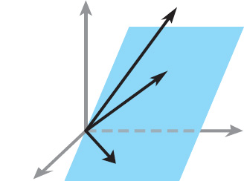
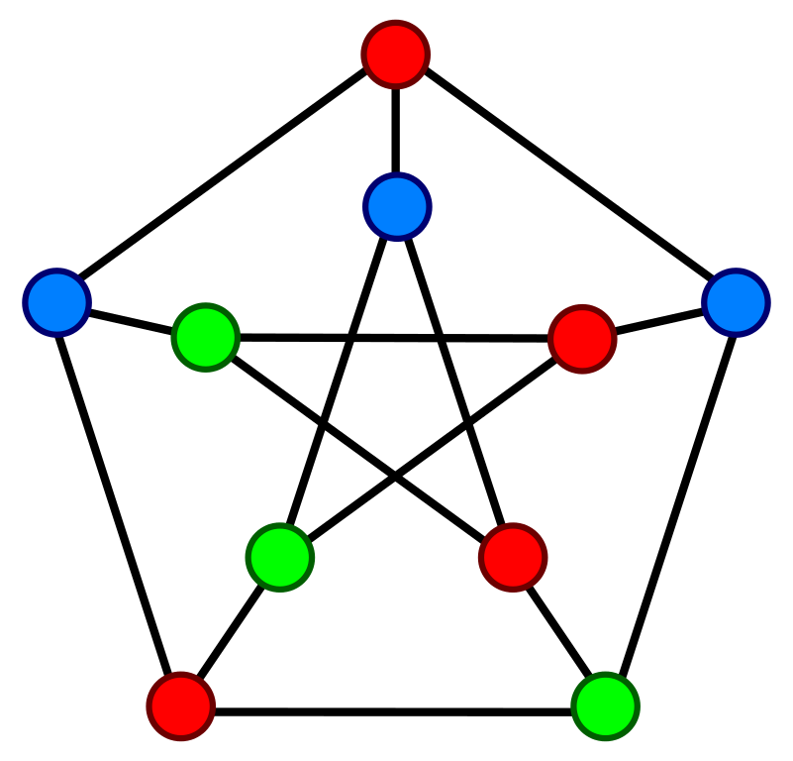
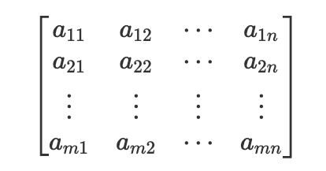
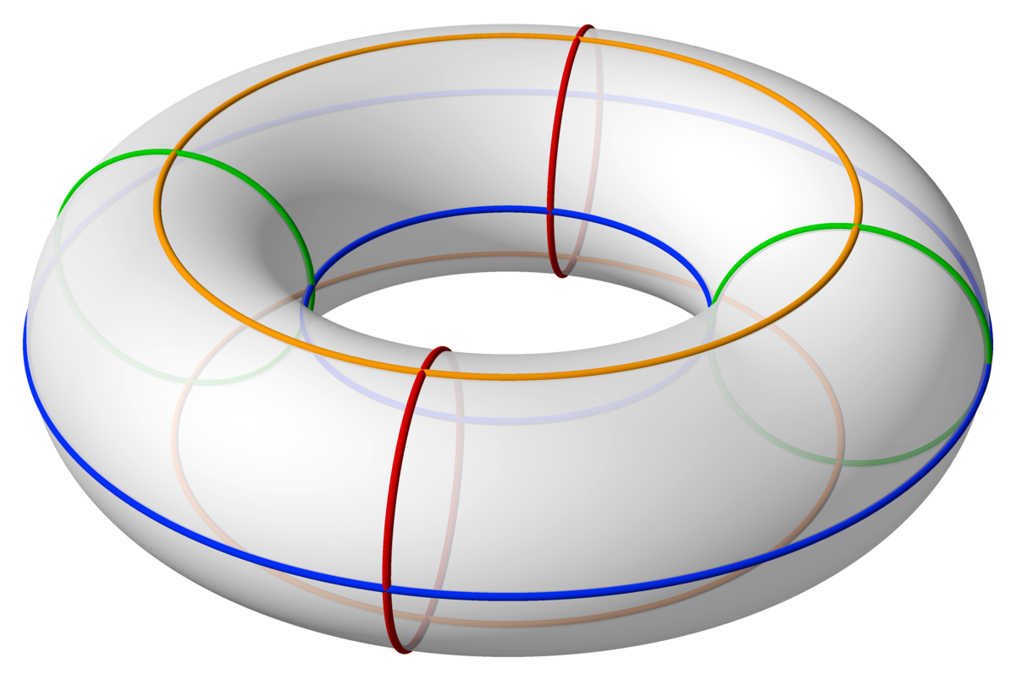
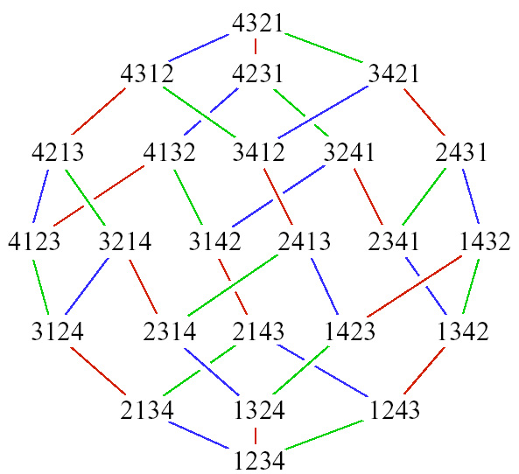
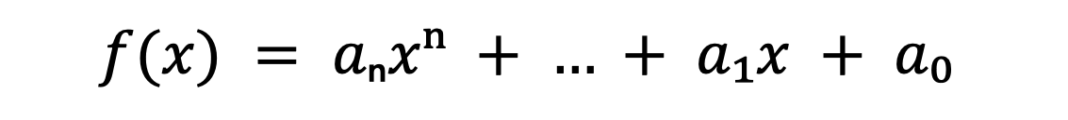
Mathematical Data
$$f(x) = aₙxⁿ + … + a₁x + a₀$$

Slide 36
About This Course
1 week: Intro
2 weeks: Data Science in Mathematics
2 weeks: Deep Learning in Mathematics
3 weeks: Math as an NLP problem (LLMs etc.)
3 weeks: Reinforcement Learning (RL) in Math
1 week: Advanced AI topics
1 week: Project Presentations

Slide 37
Thank you!

